Slide 1


Recognition of transport methods
MEI – Ambient intelligence 2022-07-19
1
Presentation of practical work
Profile 1
Alvar San Martín
https://github.com/AlvarSML/AmbientIntelligence_Coimbra22

Slide 2
Index
Recognition of transport methods 2022-07-19
2
Motivation
Objectives and contributions
Related works
Architecture & data analysis
Collection of data
Data visualization
Data processing
Test and validation
Data availability and privacy
Conclusions and future work

Slide 3
Motivation
Recognition of transport methods 2022-07-19
3
Obtention of context data in real time
Creation of a base to provide information for other proposes
The user knows what is doing, the apps he is using normally no

Slide 4
Objectives and contributions
Recognition of transport methods 2022-07-19
4
Objectives
Creation of a machine learning model able to classify transportation methods
The data will be obtained from smartphone sensors
Not to depend on only GPS data
Contributions
To create a classification method not dependant on 3rd parties, like the google one.

Slide 5
Related works
Recognition of transport methods 2022-07-19
5
A. A. F. V. J. B. a. J. P. S. C. João G. P. Rodrigues, «A Mobile Sensing Architecture for Massive Urban Scanning,»– To understand the sense my city architecture
M. G. C. M. D. M. N. R. M. L. a. M. G. Vito Janko, «ross-location transfer learning for the sussex-huawei locomotion recognition challenge.,». Base of the acceleration based classification
B. A. A. S. Young-Ji Byon, «Real-Time Transportation Mode Detection via Tracking Global Positioning System Mobile Devices,» For managing spatial features

Slide 6
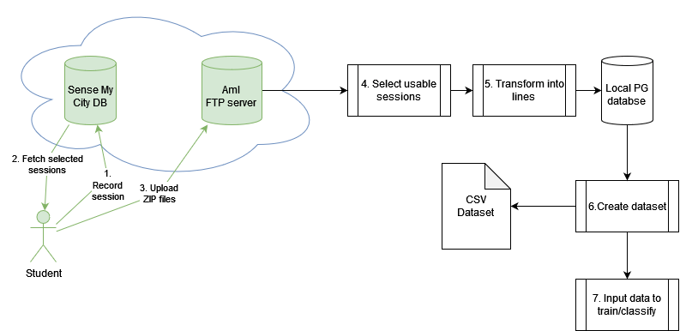
Architecture / Data Analysis
Recognition of transport methods 2022-07-19
6
Profile 1: Green is the common architecture

Slide 7

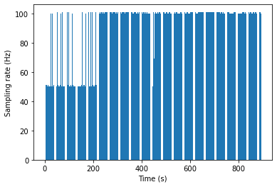
Collection of data
Recognition of transport methods 2022-07-19
7
Sensors
Accelerometer (m/s)
Gyroscope (rad/s)
GPS, only the speed (m/s)
The desired sampling rate is 50hz but is impossible to enforce it due to limitations of the Android App
Features from frequency domain seems to compensate the different sampling rates
The GPS sampling rate is 1hz, but is not 100% reliable to get a recording
Geographical information (lat, lon, alt) is only used to visualize data, not in the model because it don't provide information by itself.

Slide 8
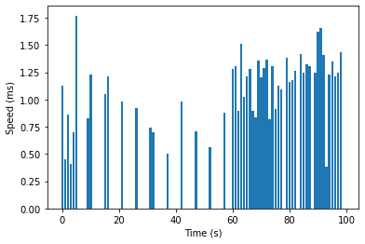
The problem with GPS recordings
Recognition of transport methods 2022-07-19
8

Slide 9
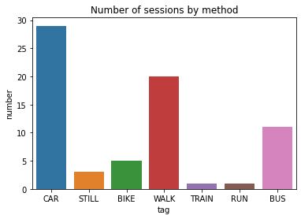
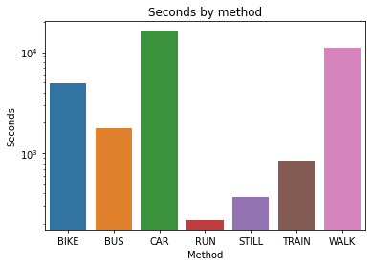
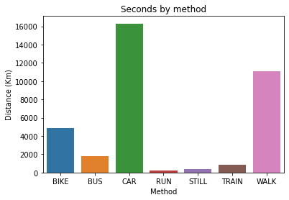
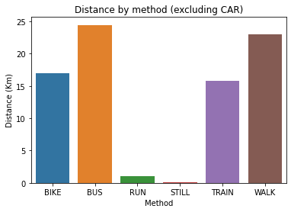
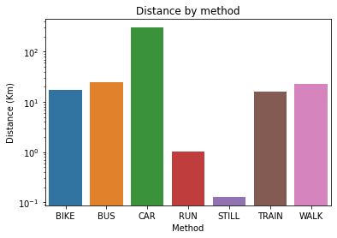
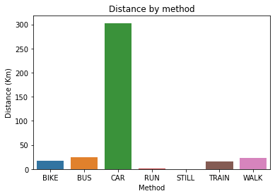
Data visualization
Recognition of transport methods 2022-07-19
9
Sec

Slide 10
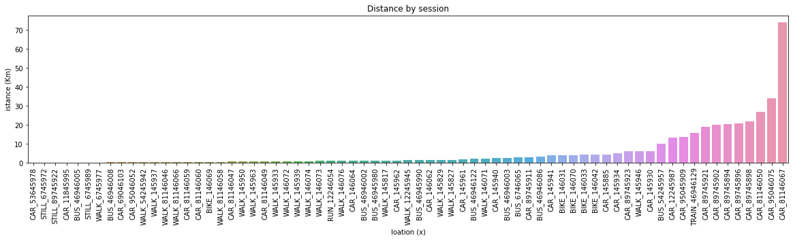
Recognition of transport methods 2022-07-19
10

Slide 11
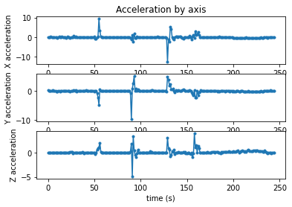
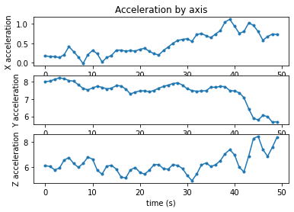
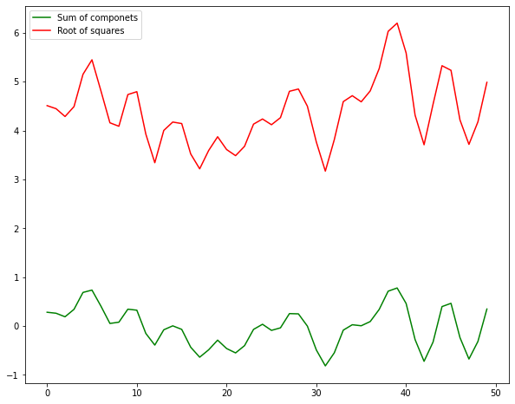
Acceleration sensors
Recognition of transport methods 2022-07-19
11
Gyroscope
Accelerometer

Slide 12
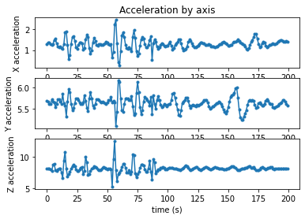
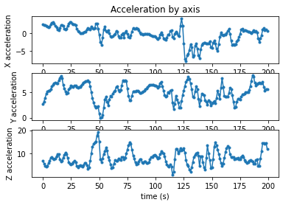
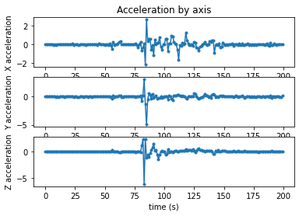
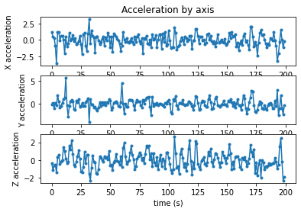
Recognition of transport methods 2022-07-19
12
CAR
WALK
Accelerometer
Gyroscope

Slide 13
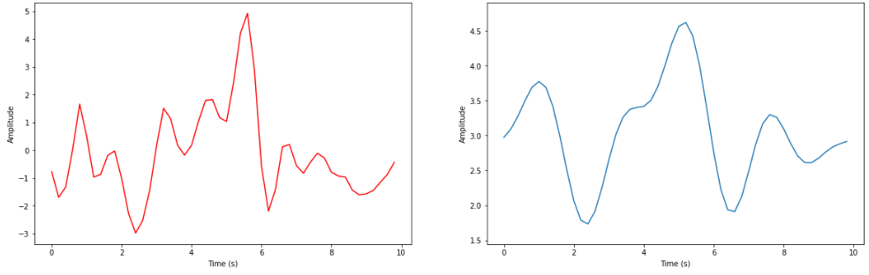
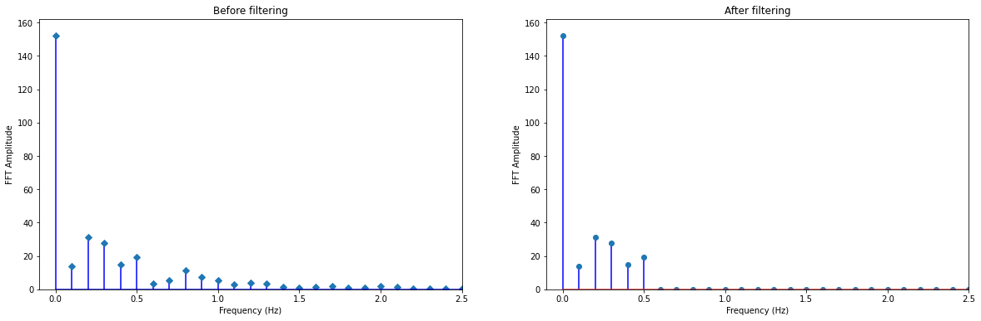
FFT
Recognition of transport methods 2022-07-19
13

Slide 14
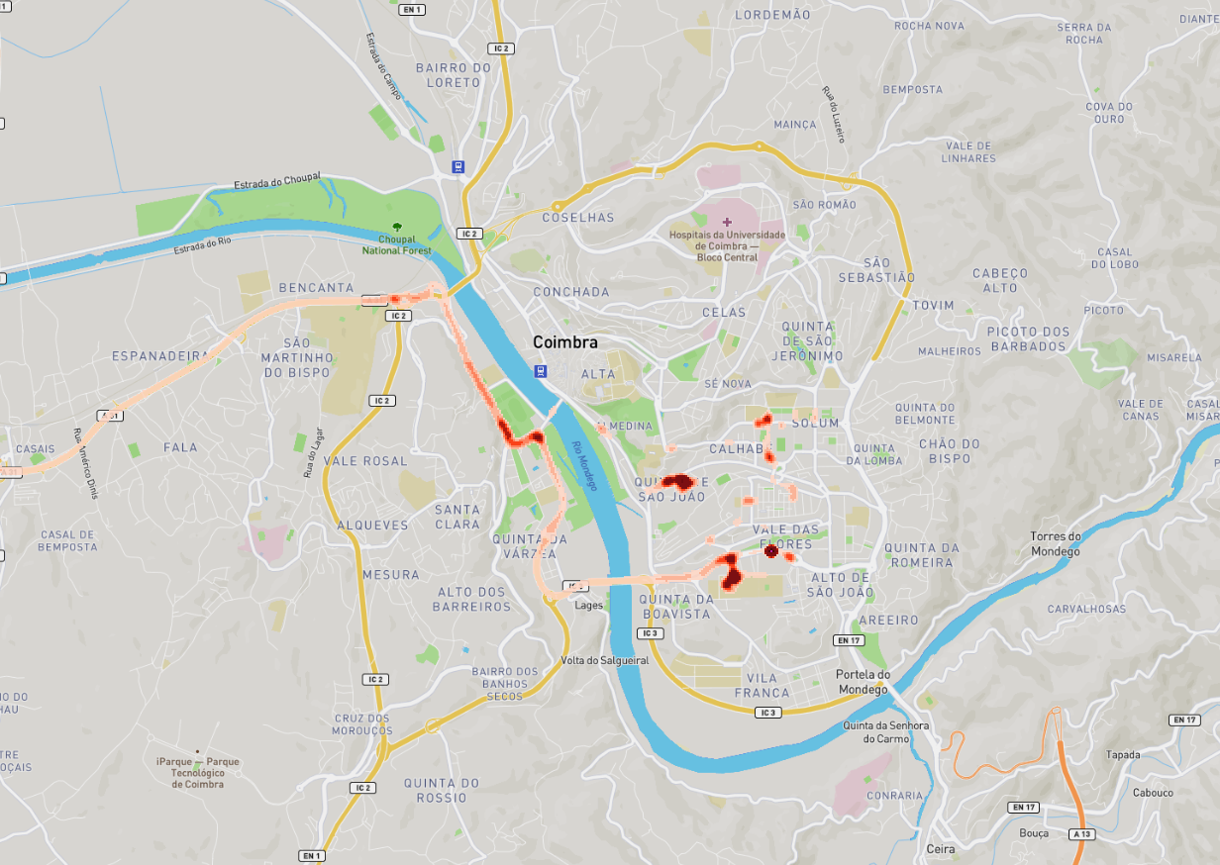
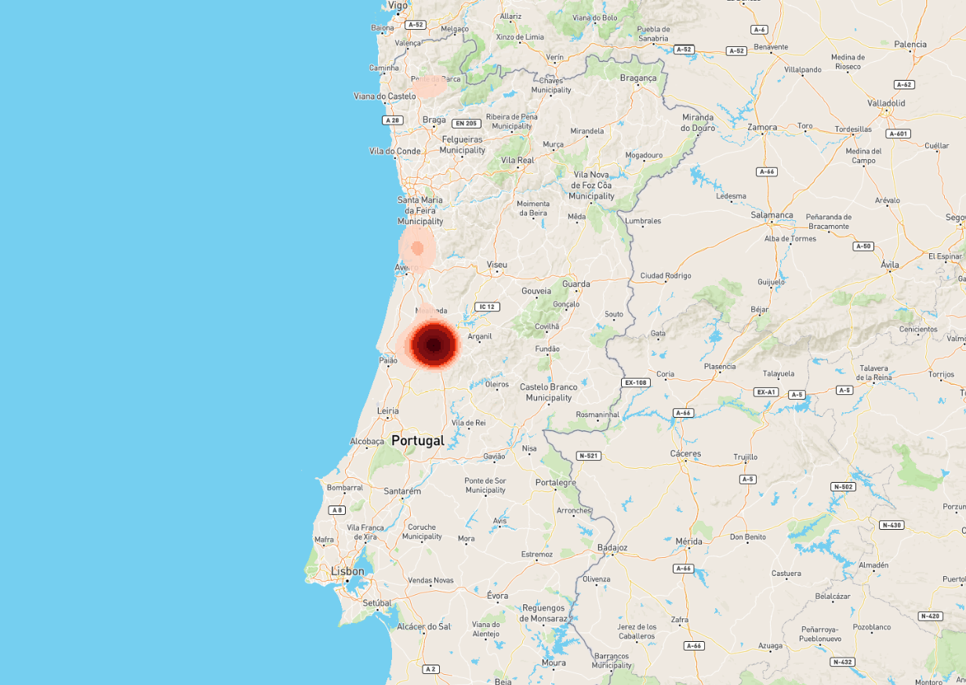
Heatmap of the sessions

Slide 15

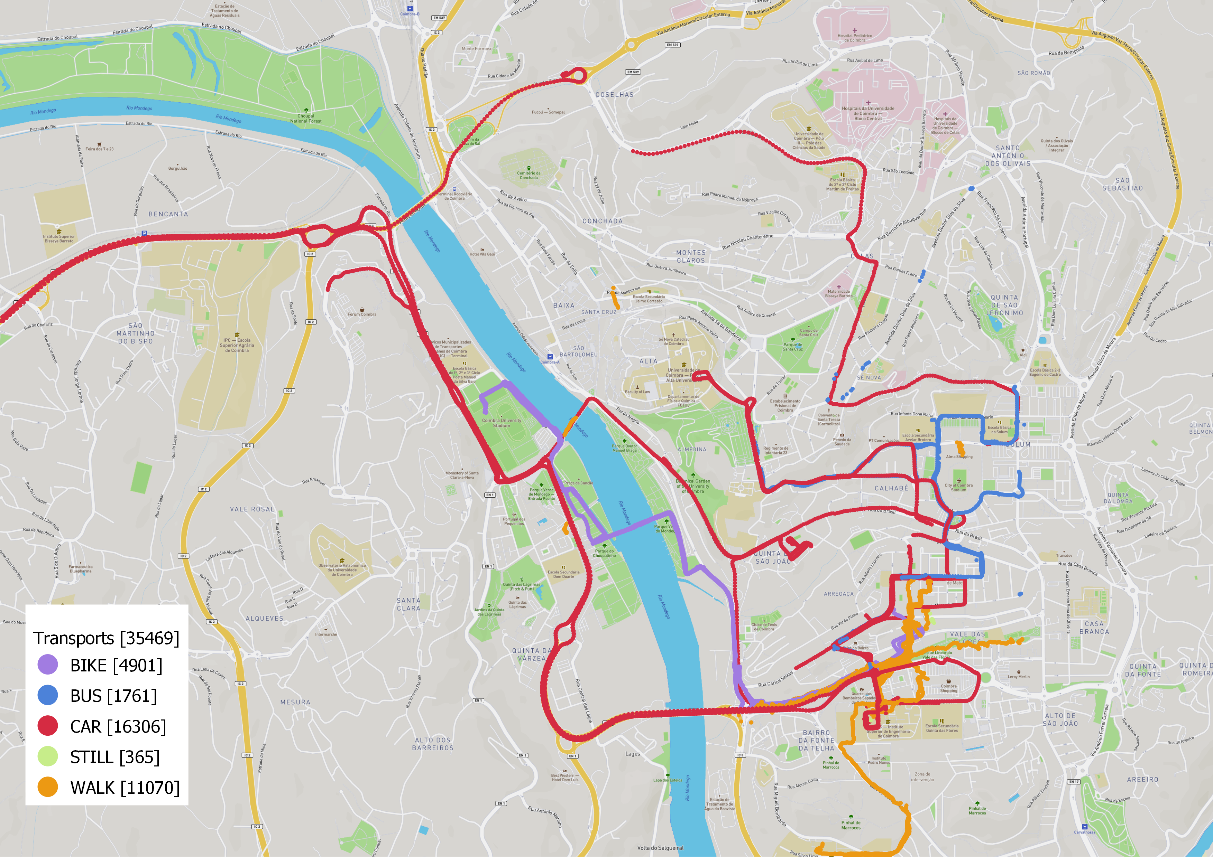
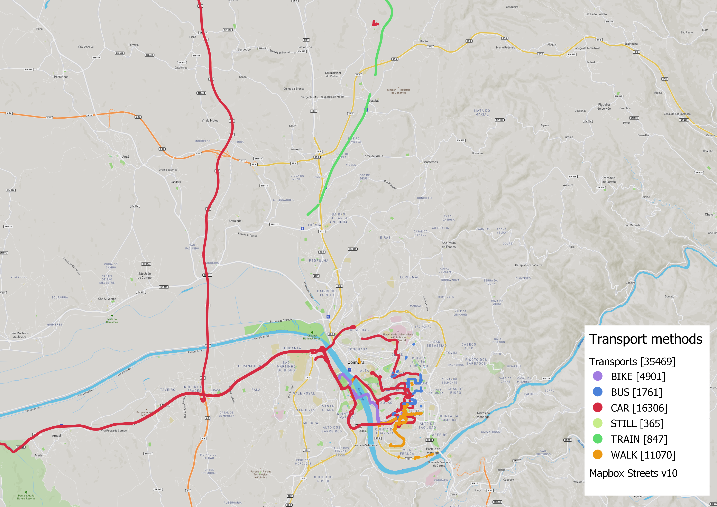
Traces of the sessions by method
Recognition of transport methods 2022-07-19
15

Slide 16

Data processing
Recognition of transport methods 2022-07-19
16
Context dimensions:
Who: Individual user
Where: Outdoors, in a path between locations
What: The method the user is using to move
When: Is not relevant

Slide 17
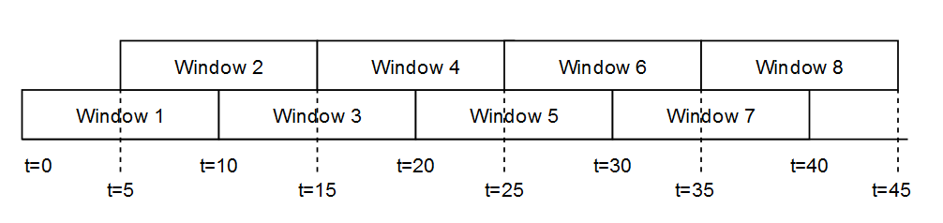
Windowing
Recognition of transport methods 2022-07-19
17
In order to classify the data, each session is partitioned in smaller parts or “Windows”
Windows can overlap each other to get more density of data.
Windows have a length and a offset
Windows with length 10 and a 50% offset

Slide 18
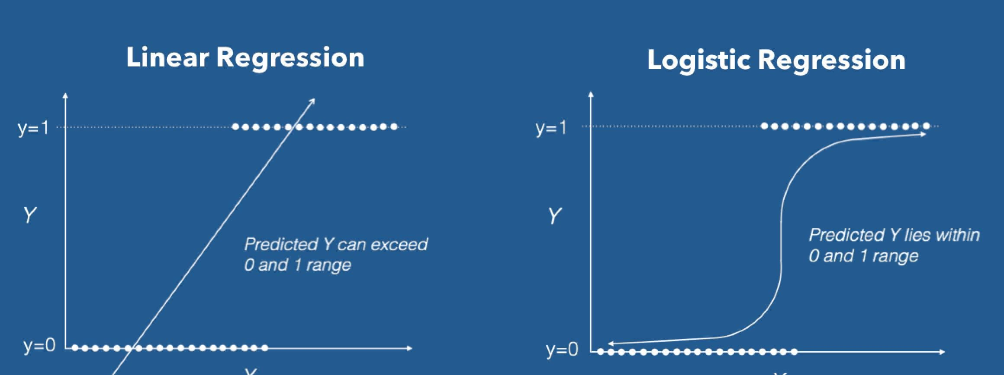

Machine learning algorithm
The objective classification
The main algorithm is logistic regression for n classes, saga solver

Slide 19
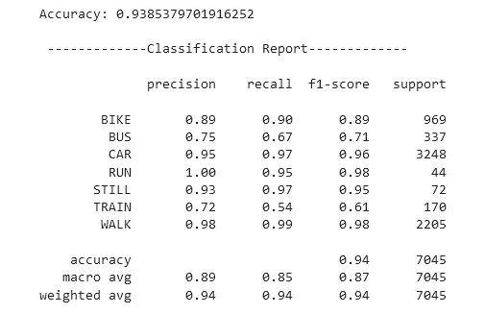
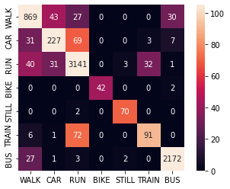
Test and Validation
Recognition of transport methods 2022-07-19
19
To get a initial evaluation of the model we use a test set (40% of the original dataset)
For a more reliable evaluation cross-validation is used, with 10 folds
A confusion matrix is useful to visualize errors
Testing of the model (w=4s,o=50%)
Testing of the model
Confusion matrix

Slide 20
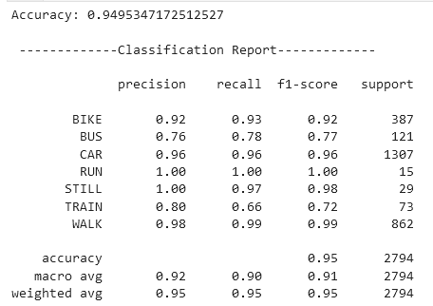
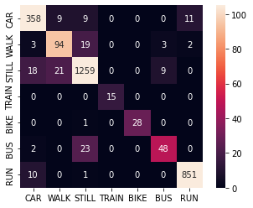
W=10, O=50% W=4, O=50%

Slide 21
Data availability and privacy
Recognition of transport methods 2022-07-19
21
The focus is to give information for other programs not to the user
The dataset is only used to train the model
If user data is collected to train the model again, it would be only stored in the user’s phone

Slide 22
Conclusions and future work
Recognition of transport methods 2022-07-19
22
Conclusions:
The window size is important in classification accuracy
Overlapping of windows can improve models on unbalanced datasets
Different rates of sampling apparently don’t have a lot of impact on the model
Future work/applications:
Implement model on an android app for real time classification
Try to obtain speed integrating acceleration data for faster sampling rates
Try different ML algorithms and online learning

